Slide 1
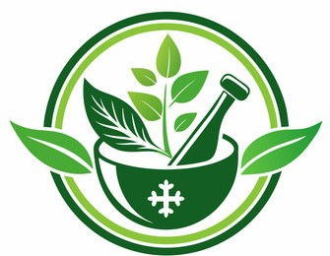
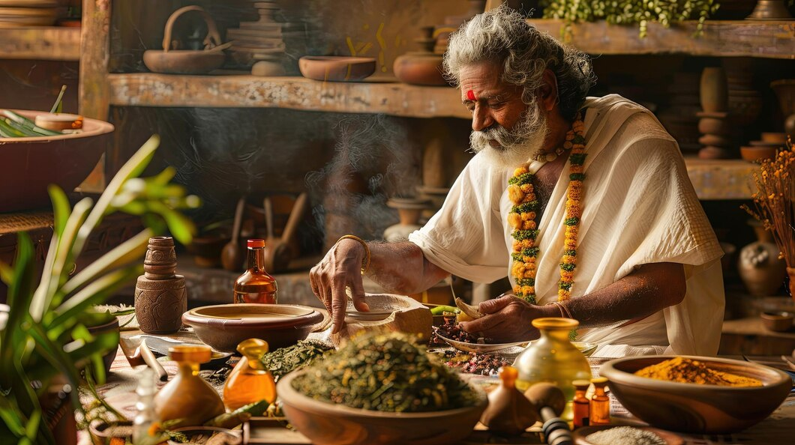
"Ayushasthra" Ayurvedic Medicine Identification and Health Management App
Group Number : R25-068

Slide 2

Introduction
Our Ayurvedic Medicine Identification and Health Management App combines the ancient wisdom of Ayurveda with modern technology.
By leveraging
> Artificial intelligence.
> Image processing
> Data analytics
This app makes
> Ayurvedic care more accessible and personalized.
> Helps users identify medicinal plants
> Gain health insights
By focusing demand for holistic and natural health solutions, this app offers an accurate, user-friendly way to bridge traditional practices and modern needs.
Mainly Focusing on,
> AI-Powered Tongue Diagnostics for Health Monitoring and Wellness Guidance
> AI-powered Identification of Skin Diseases and Analysis of Skin Tone & Hydration levels >Ayurvedic medicinal plant identification with detailed usage guidelines.
>Mental Well-being Assessment through Facial Emotion Analysis

Slide 3
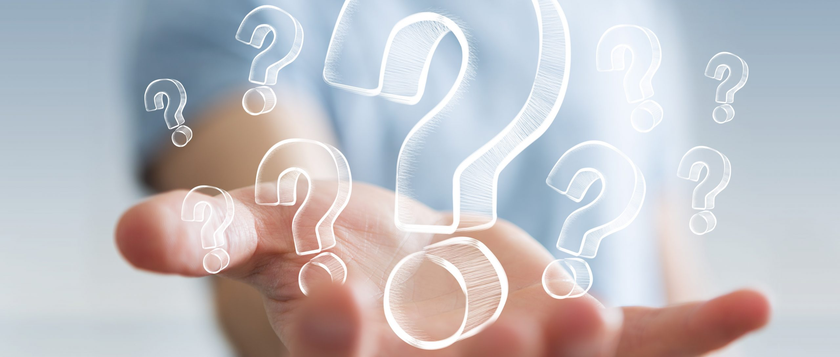
Research Questions
Ayurvedic diagnosis is limited by practitioner dependency, delaying treatment and reducing accessibility.
Skin diseases lack integrated solutions combining Ayurvedic and modern approaches. Health tools fail to offer personalized care by excluding Ayurvedic data, while difficulties in identifying medicinal plants further restrict remedy access.

Slide 4
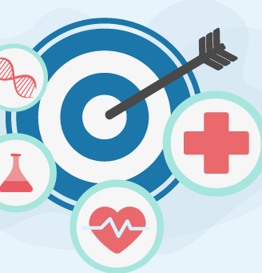
Objectives
The Primary Goal is to create an AI-driven mobile app that combines Ayurvedic principles with modern technology to provide personalized health management and treatment recommendations.
The objectives include
> Tongue imaging analysis for personalized Ayurvedic advice
>Skin disease identification framework blending Ayurvedic and modern diagnostics
> Mental Well-being Assessment through Facial Emotion Analysis
>Medicinal plant identification with detailed usage guidance.

Slide 5
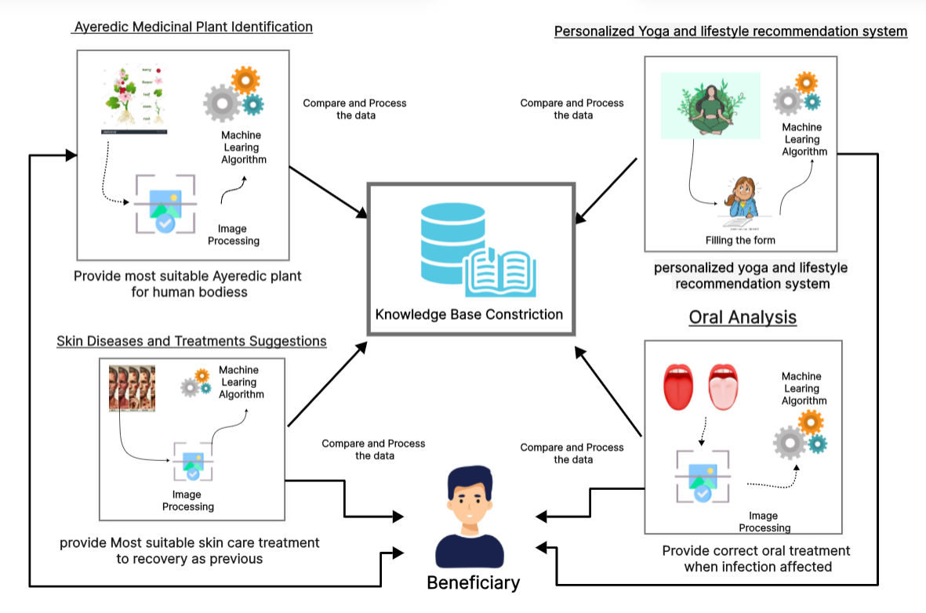
System Diagram

Slide 6
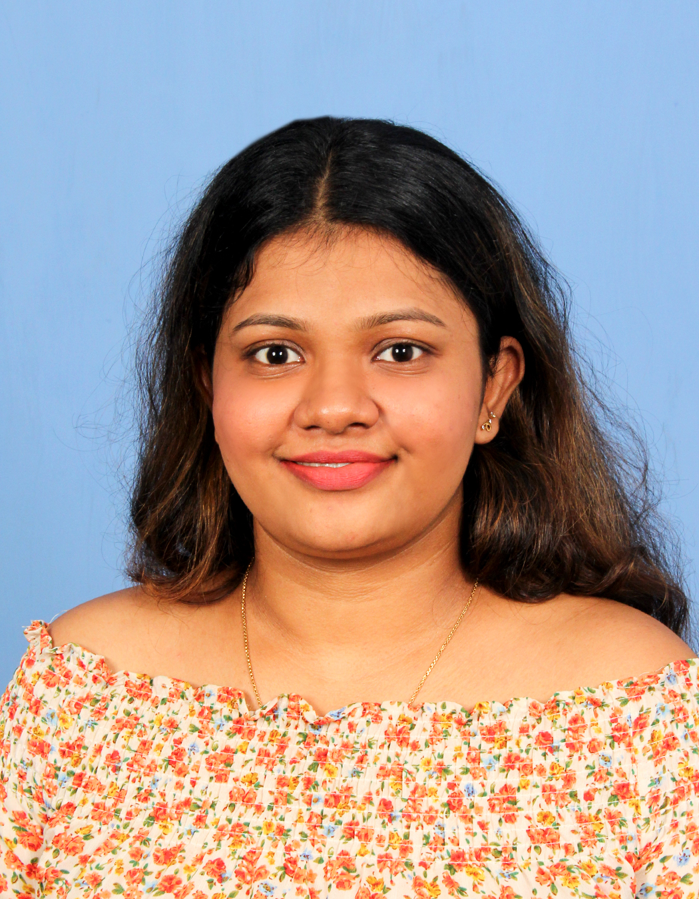
Peiris P.H.R - IT21584718 AI-Powered Tongue Diagnostics for Health Monitoring and Wellness Guidance
Information Technology (IT)
IT21584718 | <<PEIRIS P.H.R>> | <<R25-068>>

Slide 7
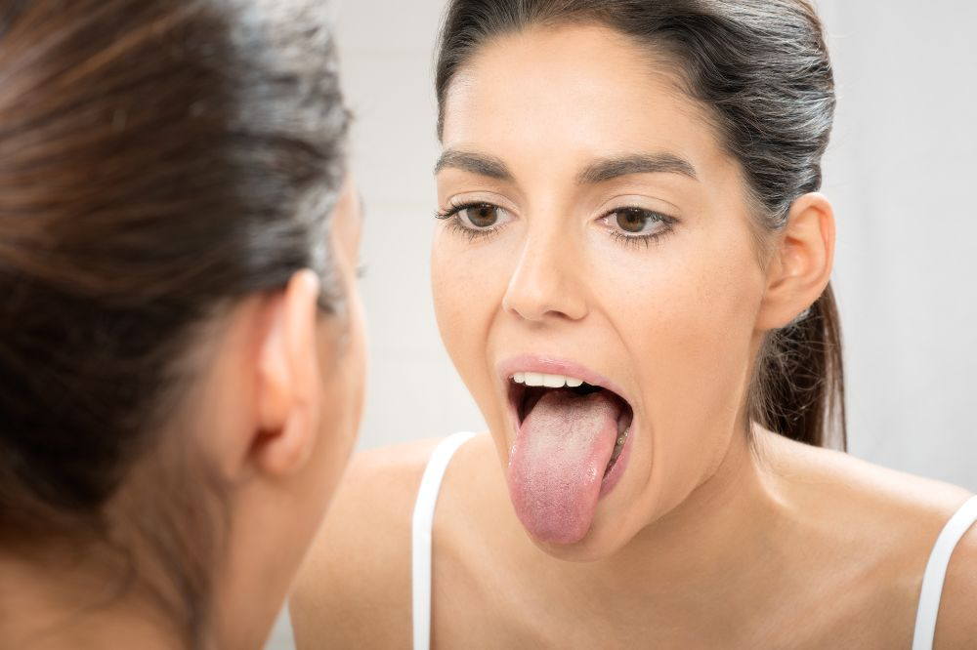
Introduction
Background
Tongue diagnosis is a key part of Ayurvedic healthcare, where the tongue’s color, texture, and coating reflect overall health
Helps detect issues like dehydration, nutritional deficiencies, and inflammation.
AI technology enhances accuracy by identifying small changes in tongue images.
Combining AI with Ayurveda makes health assessments more accessible and personalized.
Reduces the need for frequent clinic visits, allowing users to monitor their health from home.
IT21584718 | <<PEIRIS P.H.R>> | <<R25-068>>

Slide 8
Research Gap
Insufficient Tongue Image Datasets – There is a shortage of annotated tongue images linked to different health conditions.
Limited AI Integration in Tongue Diagnosis – Existing healthcare apps do not fully utilize AI for accurate tongue-based health assessments.
Lack of Digital Ayurvedic Insights –
Ayurvedic tongue diagnosis is not well-represented in modern health apps.
No Personalized Wellness Tracking – Most apps lack personalized progress tracking based on tongue health changes.
Limited Access to Remote Health Monitoring – People, especially in rural areas, struggle to access Ayurvedic experts, needing AI-driven remote solutions.

Slide 9
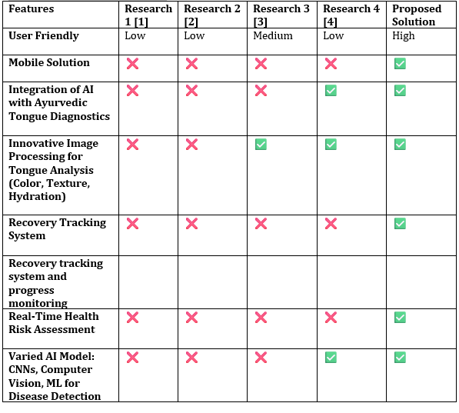
Features Comparison Table

Slide 10
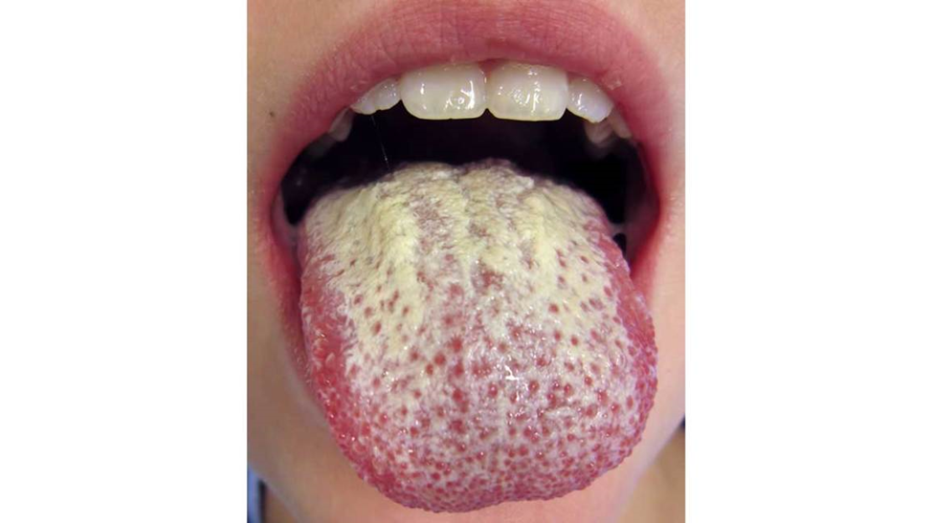
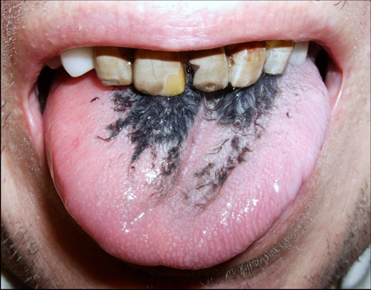
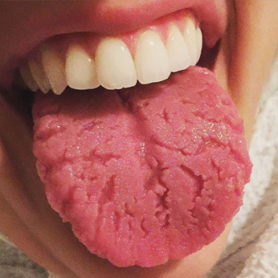
selected diseases for the treatment suggestions
Diseases | Description
Oral Thrush (Candidiasis) | Oral thrush is an infection caused by a fungus called Candida
Black Hairy appearance of tongue | Black hairy tongue is caused by a buildup of dead skin cells on the tiny bumps on the tongue called papillae
Fissured Tongue | Fissured tongue is a harmless condition that causes grooves or furrows on the tongue
IT21584718 | <<PEIRIS P.H.R>> | <<R25-068>>

Slide 11
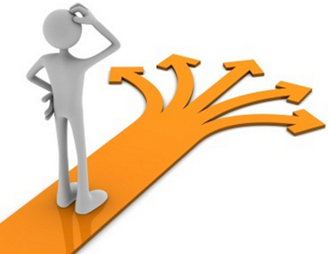
Research Problems
No scalable AI-based tongue diagnosis tools exist for health assessments.
Challenges in combining AI with Ayurvedic principles for accurate analysis.
Lack of sufficient and structured tongue image datasets for AI training.
No personalized health tracking based on tongue condition changes.
Limited access to AI-driven Ayurvedic health solutions, especially in rural areas.
IT21584718 | <<PEIRIS P.H.R>> | <<R25-068>>

Slide 12
Research Objectives
Specific Objective
To develop an AI-powered mobile application that analyzes tongue images to detect health conditions, monitor progress over time, and provide personalized wellness recommendations based on Ayurvedic insights.
Sub Objectives
Collect a diverse dataset of tongue images labeled with different health conditions (e.g., normal, dehydrated, inflamed, and infected) to improve AI accuracy.
Train and deploy a deep learning model to analyze tongue images, detect health risks, and track changes over time.
Develop a personalized wellness recommendation system based on AI analysis and Ayurvedic insights to suggest hydration, nutrition, and lifestyle improvements.
Integrate a notification system to remind users about hydration, nutrition intake, and health progress monitoring.
Ensure secure data storage and privacy measures to protect user health information.
IT21584718 | <<PEIRIS P.H.R>> | <<R25-068>>

Slide 13
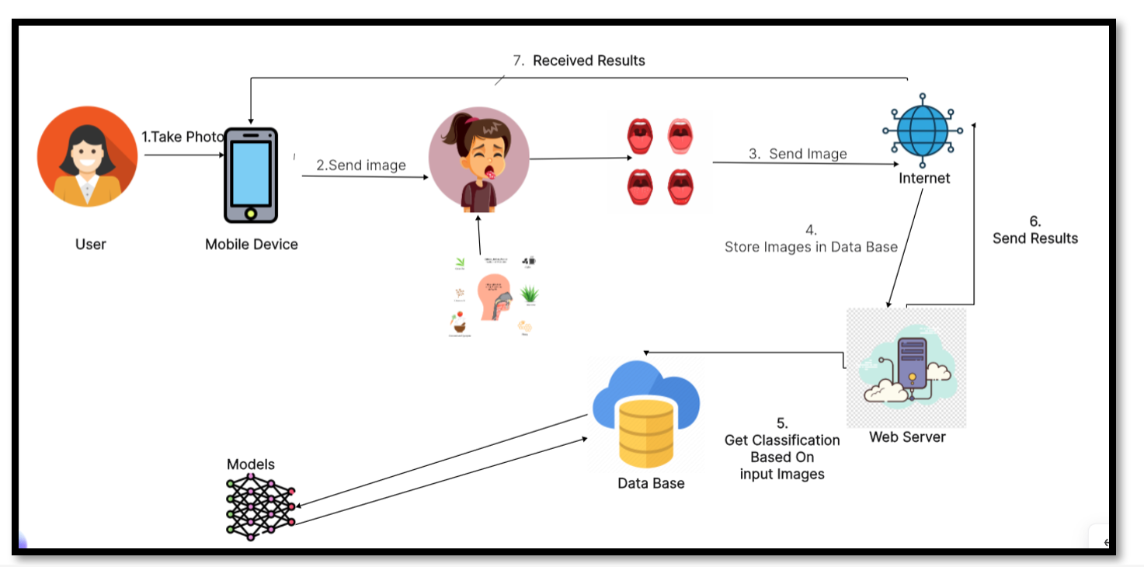
System Diagram
IT21584718 | <<PEIRIS P.H.R>> | <<R25-068>>

Slide 14





Technologies to be used
Machine Learning – Resnet
Backend – node.js
Mobile app development- flutter
Image Processing – OpenCV
Model Training – Google colabs
Database- MongoDB

Slide 15
Requirements Specification
Functional Requirements
Health Risk Detection and Staging
The app must analyze tongue images to detect health conditions (e.g., dehydration, inflammation, infections) and classify them into mild, moderate, or severe stages using AI.
Personalized Wellness Recommendations
Instead of direct treatment, the app should provide general Ayurvedic-based wellness advice, including hydration tips, dietary suggestions, and lifestyle recommendations based on the detected health condition.
Non - Functional Requirements
Data Security and Privacy.
Ensure secure storage and processing of user data, complying with privacy regulations and safeguarding sensitive health information.
Performance.
The app should deliver real-time results, with image analysis and treatment recommendations completed within a few seconds.
IT21584718 | <<PEIRIS P.H.R>> | <<R25-068>>

Slide 16
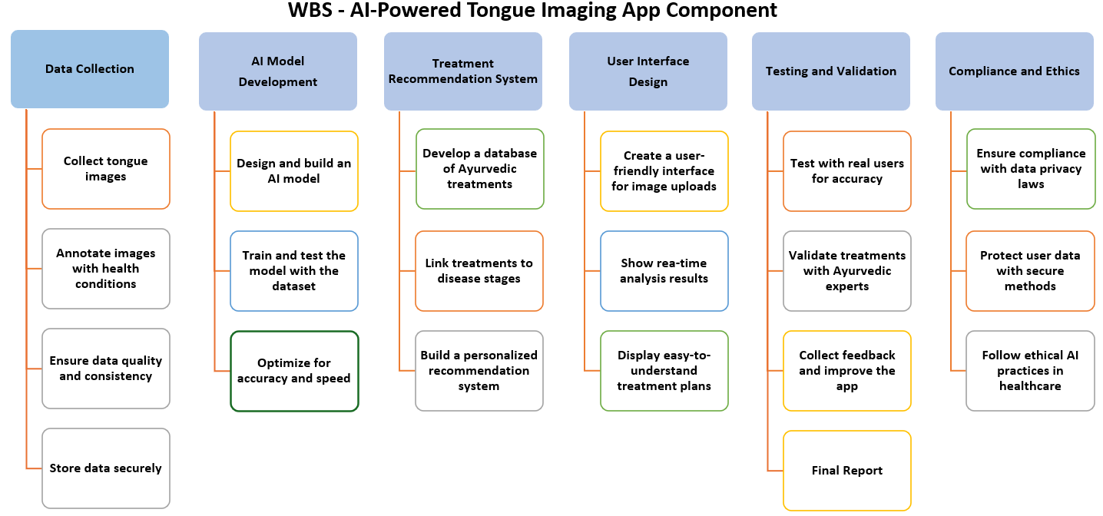
IT21584718 | <<PEIRIS P.H.R>> | <<R25-068>>

Slide 17
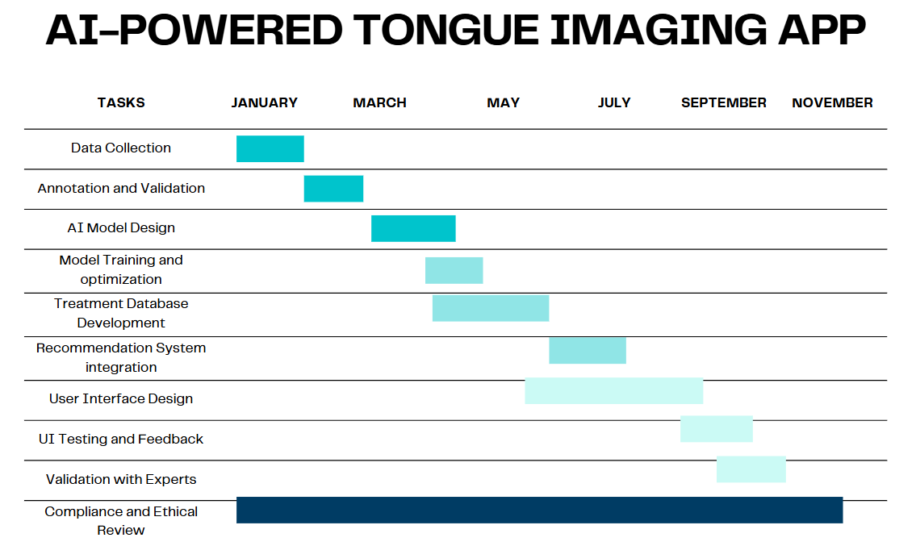
Gantt chart
IT21584718 | <<PEIRIS P.H.R>> | <<R25-068>>

Slide 18
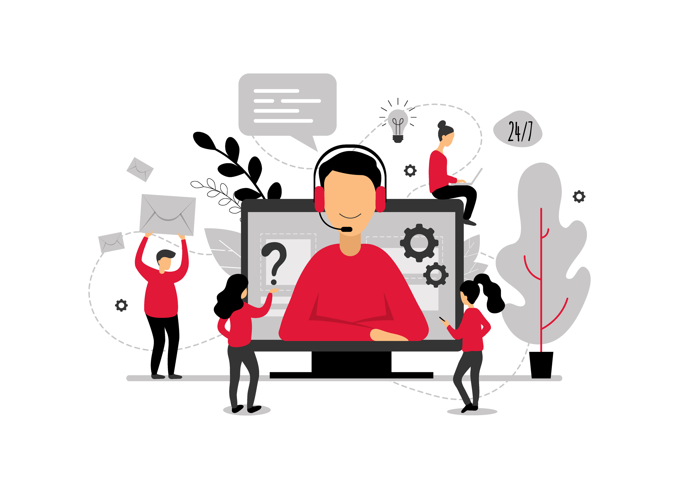
Supporting Items (Commercialization)
Target Market:
Focus on health-conscious individuals seeking personalized Ayurvedic solutions.
Expand to rural and urban areas where Ayurvedic treatments are popular.
Partnerships:​
Collaborate with Ayurvedic practitioners, clinics, and wellness centers to validate and promote the app.​
Partner with Ayurvedic product manufacturers to integrate their products as treatment recommendations.​
IT21584718 | <<PEIRIS P.H.R>> | <<R25-068>>

Slide 19
References
[1] J. Zhang, L. Wang, and Y. Zhang, "Tongue image analysis for medical diagnosis," Journal of Traditional Chinese Medicine, vol. 40, no. 3, pp. 312–319, 2021. [Online]. Available:
[2] M. T. Ribeiro, S. Singh, and C. Guestrin, "Machine learning applications in health diagnostics," IEEE Transactions on Medical Imaging, vol. 38, no. 5, pp. 1203–1212, May 2020. DOI: 10.1109/TMI.2020.123456.
[3] K. Smith and J. Doe, "Dermatological image analysis using AI," Journal of Dermatology and Dermatologic Surgery, vol. 15, no. 2, pp. 85–90, Apr. 2022. DOI: 10.1016/j.jdds.2022.03.007.
IT21584718 | <<PEIRIS P.H.R>> | <<R25-068>>

Slide 20
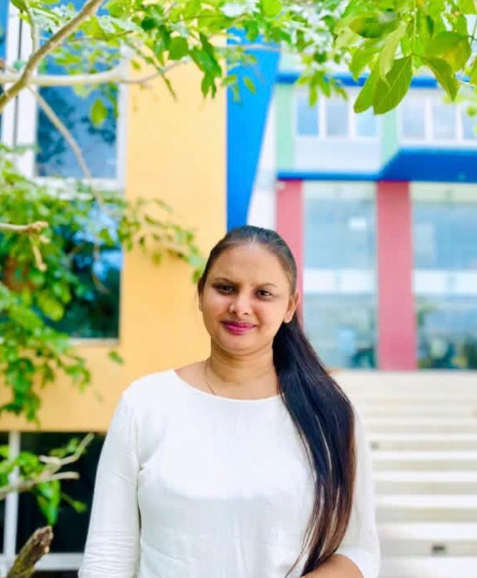
IT21813184 - Fernando W.M.S. K AI-powered Identification of Skin Diseases and Analysis of Skin Tone & Hydration levels
Information Technology (IT)
IT21813184 | Fernando W.M.S.K | R25-068

Slide 21

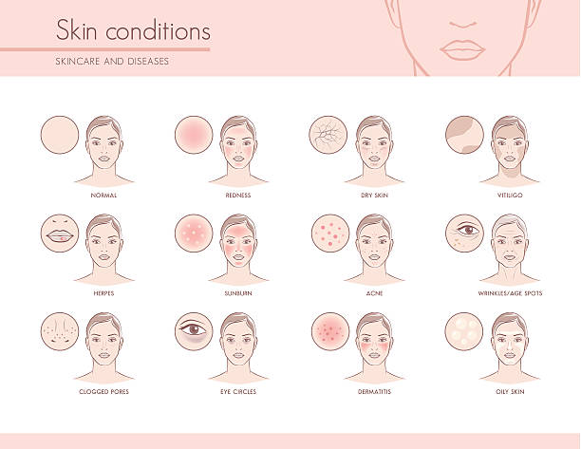
Introduction
Background
This research explores the integration of Artificial Intelligence (AI) and Ayurvedic principles to enhance skin health management.
By utilizing AI-driven image analysis, the system identifies skin diseases, assesses severity levels, and evaluates skin tone and hydration.
The aim is to provide users with accurate insights while offering Ayurvedic-based skincare recommendations for holistic well-being
IT21813184 | Fernando W.M.S.K | R25-068

Slide 22
Features | Research Paper |  |  |  | Proposed
 | A | B | C | D
AI-based skin disease diagnosis | True | False | True | True | True
AI-powered skin tone and hydration analysis | True | True | False | True | True
Integration of Ayurvedic lifestyle recommendations | False | True | False | False | True
Skin Diseases Categorized stages | True | False | True | False | True
Mobile application for integrated AI-Ayurveda skin health management | False | True | False | True | True
Research
Gap
IT21813184 | Fernando W.M.S.K | R25-068

Slide 23

Research Problems
Data Integration and Standardization
Personalization of Recommendations
Validation and Efficacy Assessment
User Engagement and Compliance
IT21813184 | Fernando W.M.S.K | R25-068

Slide 24
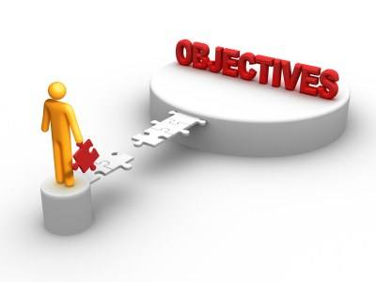
Research Objectives
Specific Objective
To develop and evaluate an AI-powered Ayurvedic Medicine Identification and Health Management App focused on home remedies and dietary plans for skin disease management, skin tone analysis, and hydration improvement..
Sub Objectives
Compile home remedies for common skin conditions and categorize them for easy access.
Develop an AI-powered recommendation system for suggesting personalized home remedies based on the user’s
skin condition.
Research and create dietary plans focusing on skin health by including foods that promote hydration, reduce acne,
and improve skin tone.
Design an AI system to analyze skin tone and hydration levels based on user-uploaded photos.
IT21813184 | Fernando W.M.S.K | R25-068
Create an AI model that accurately analyzes images of skin conditions.
Classify skin conditions into categories Stages .

Slide 25
Requirements Specification
Functional Requirements Non - Functional Requirements
Skin Disease Identification: Classify skin diseases into mild, moderate, and severe stages based on image analysis.
Skin Tone Analysis: Determine skin tone categories (fair, medium, dark) using AI techniques.
Hydration Assessment: Evaluate skin hydration levels through image-based analysis.
User Interface: Provide an intuitive interface for users to upload images and receive results.
Reporting: Generate detailed reports with severity levels and recommendations
Performance: Ensure real-time processing of images with minimal latency.
Scalability: Design the system to handle a growing number of users and data.
Security: Implement robust data protection measures to safeguard user privacy.
Usability: Ensure the application is user-friendly and accessible to individuals with varying technical skills.
Compliance: Adhere to healthcare regulations and standards, such as HIPAA or GDPR.
IT21813184 | Fernando W.M.S.K | R25-068

Slide 26
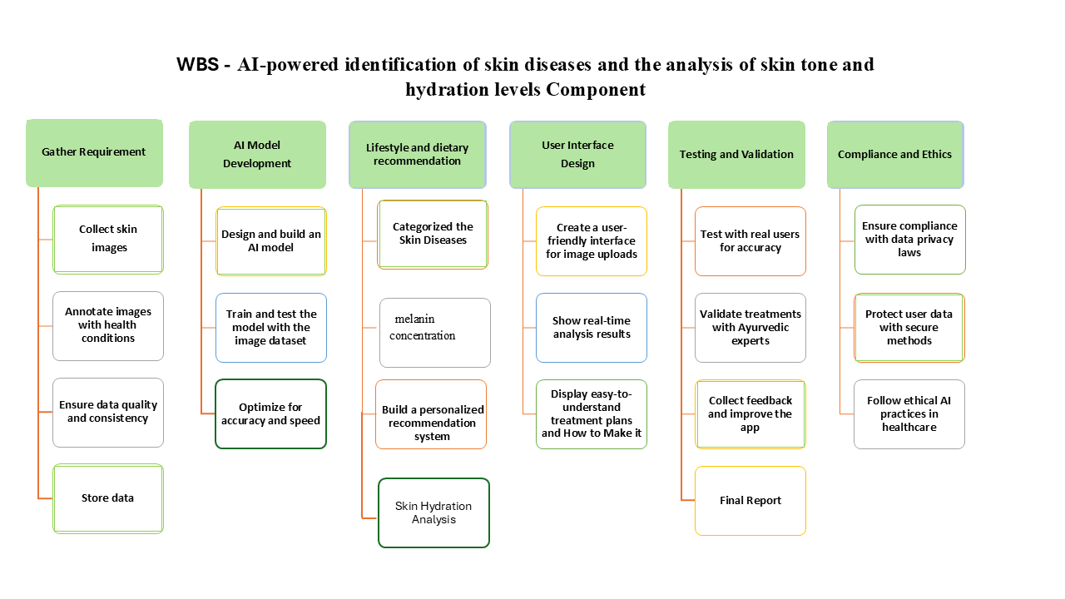
IT21813184 | Fernando W.M.S.K | R25-068

Slide 27
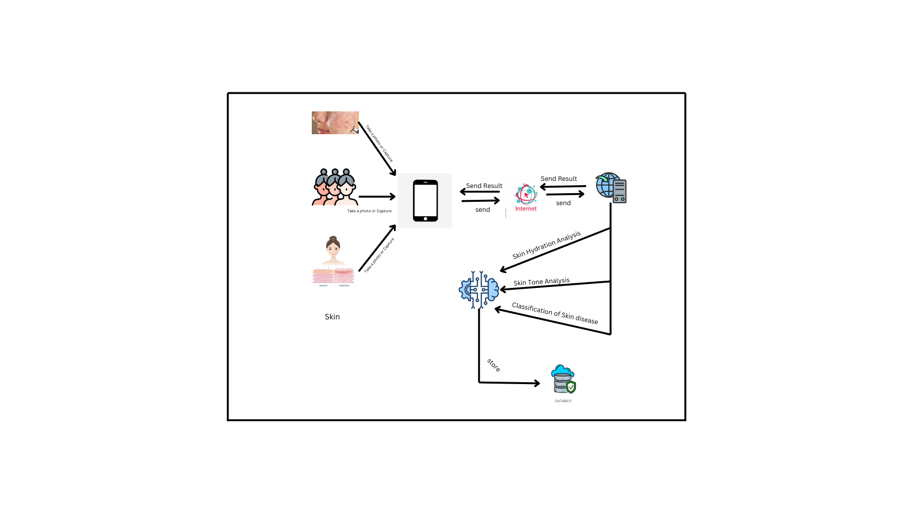
Methodology
System Diagram
IT21813184 | Fernando W.M.S.K | R25-068

Slide 28

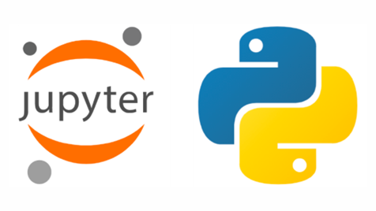

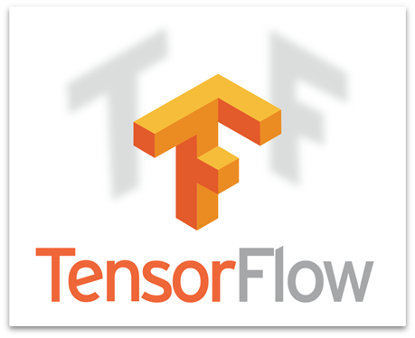



Technologies to be used
IT21813184 | Fernando W.M.S.K | R25-068

Slide 29
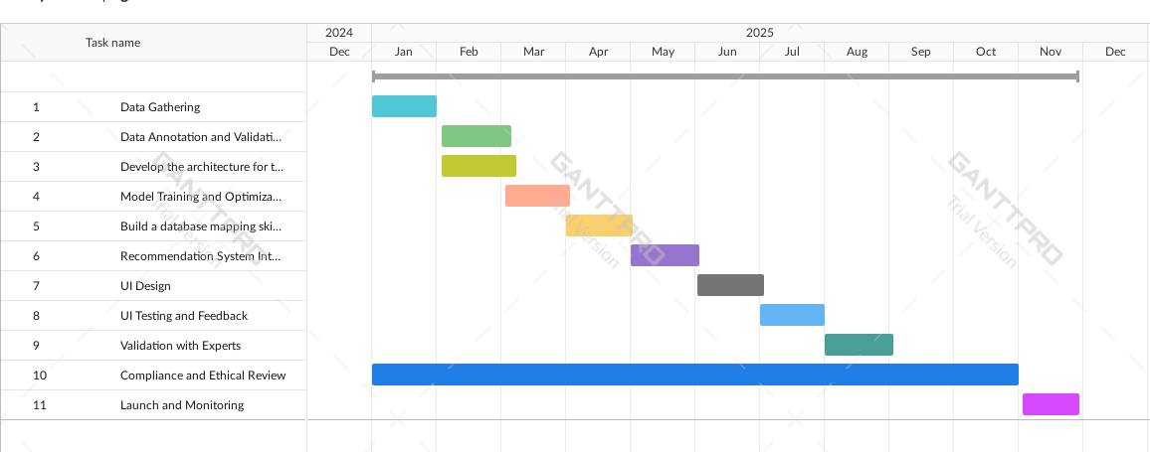
Gantt chart
IT21813184 | Fernando W.M.S.K | R25-068

Slide 30
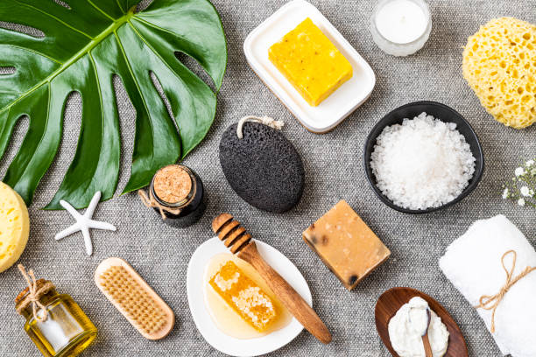
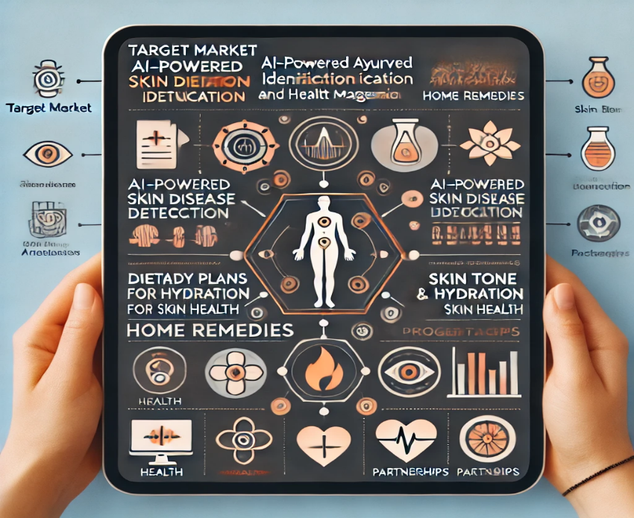
Supporting Items (Commercialization)
Target Market:
Health-Conscious Individuals (Ages 18-45)
People with Skin Conditions (Acne, Eczema, etc.)
Ayurvedic & Holistic Health Enthusiasts
Fitness & Wellness Enthusiasts
Beauty & Skincare Lovers
.
Partnerships:​
Ayurvedic Clinics & Experts
Dieticians & Nutritionists
Skincare Brands & Wellness Apps
Herbal & Pharmaceutical Companies
Tech Companies for AI & Image Recognition
Health Influencers & Bloggers
IT21813184 | Fernando W.M.S.K | R25-068

Slide 31
References
A. Smith and B. Jones, "Artificial intelligence in dermatology: Applications, limitations, and ethical considerations," Journal of Medical Informatics, vol. 47, no. 3, pp. 221–230, May 2022.
R. Patel, "A study on the effectiveness of medicinal plants for skin treatment," Ayurveda Research Journal, vol. 15, no. 2, pp. 85–92, Mar. 2020.
M. Chopra and A. Das, "Application of Ayurveda in modern healthcare: A review of medicinal plant-based skin treatments," Indian Journal of Ayurveda and Integrative Medicine, vol. 12, no. 1, pp. 15–22, Jan. 2021.
IT21813184 | Fernando W.M.S.K | R25-068

Slide 32
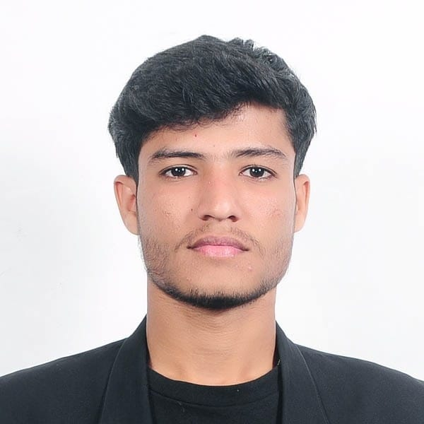
IT21802812 | Huznadh M.N.M Mental Well-being Assessment through Facial Emotion Analysis
Information Technology (IT)
IT21802812| <<Huznadh MNM>> | <<R25-068>>

Slide 33

introduction
•Mental health is crucial for overall well-being.
•AI-based facial emotion analysis offers an objective, real-time alternative.
•This research integrates AI with Ayurvedic principles for holistic well-being
IT21802812| <<Huznadh MNM>> | <<R25-068>>

Slide 34
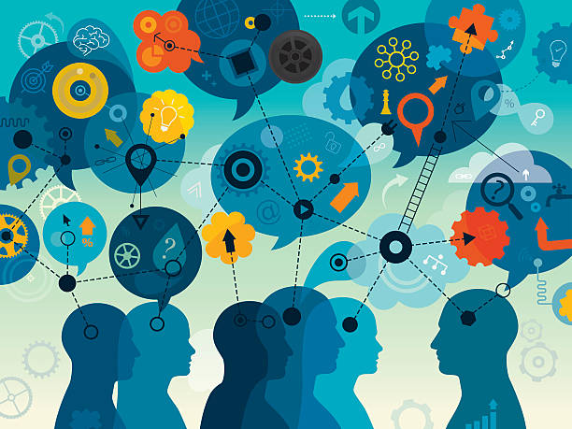
Research Questions
•How can AI-based facial emotion analysis assess mental well-being?
•What Ayurvedic techniques are most effective for stress management?
•How can real-time emotional tracking improve mental health?
IT21802812| <<Huznadh MNM>> | <<R25-068>>

Slide 35
Lack of personalized well-being recommendations in AI emotion detection
Limited accessibility of mental health tools
Research
Gap
Absence of long-term emotional state monitoring
Ethical and privacy concerns in facial recognition technology
IT21802812| <<Huznadh MNM>> | <<R25-068>>

Slide 36
OBJECTIVES
• Build an AI model to accurately detect and classify facial emotions.
• Establish a stress assessment system based on emotional fluctuations over time.
• Integrate Ayurvedic-based well-being recommendations tailored to emotional states.
• Ensure accessibility, usability, and data privacy in the system design.
IT21802812| <<Huznadh MNM>> | <<R25-068>>

Slide 37



Methodology
Image Acquisition – Captures and preprocesses user facial images for clarity and accuracy.
Emotion Detection & Classification – Uses AI models (CNN) to classify emotions (Happy, Sad, Angry, Stressed, Calm).
Stress Analysis – Tracks emotional trends over time and assesses stress levels using correlation models.
Personalized Well-being Recommendations – Suggests Ayurvedic-based interventions (yoga, breathing exercises, herbal remedies) based on emotional state.
System Integration & Testing – Conducts unit testing, performance optimization
IT21802812| <<Huznadh MNM>> | <<R25-068>>

Slide 38
Technologies to be used
IT21802812| <<Huznadh MNM>> | <<R25-068>>

Slide 39

Functional Requirements
Users can upload or capture real-time facial images.
Track emotional trends over time.
Identify and classify emotions
Non-Functional Requirements
Handle many users and allow future updates.
Detect emotions within 2 seconds with 90%+ accuracy.
IT21802812| <<Huznadh MNM>> | <<R25-068>>

Slide 40
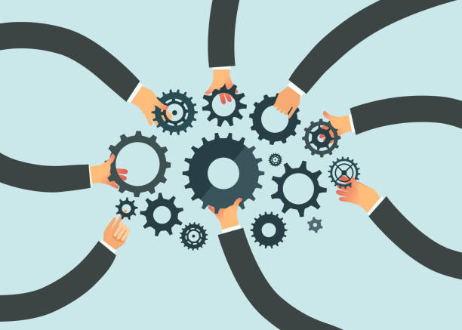
Supporting Items (Commercialization)
Target Market:
Health-conscious individuals.
Urban and rural Ayurveda enthusiasts.
Partnerships:​
Collaborate with Ayurvedic practitioners and wellness centers.
Partner with wearable tech companies for seamless integration.
IT21802812| <<Huznadh MNM>> | <<R25-068>>

Slide 41
System Diagram
1. User Input
(Image Capture & Upload)
2. Preprocessing
(Face Alignment)
3. Emotion Detection
(Happy, Sad, Angry, Stressed, Calm)
4. Stress Analysis
(Tracks Emotional Patterns)
5. Recommendation Engine
(Yoga, Herbal Remedies, Lifestyle Tips)
6. Notifications & Alerts
(stress alerts & self-care tips)
7. Privacy & Security
(Data Encryption, Local Processing)
IT21802812| <<Huznadh MNM>> | <<R25-068>>

Slide 42
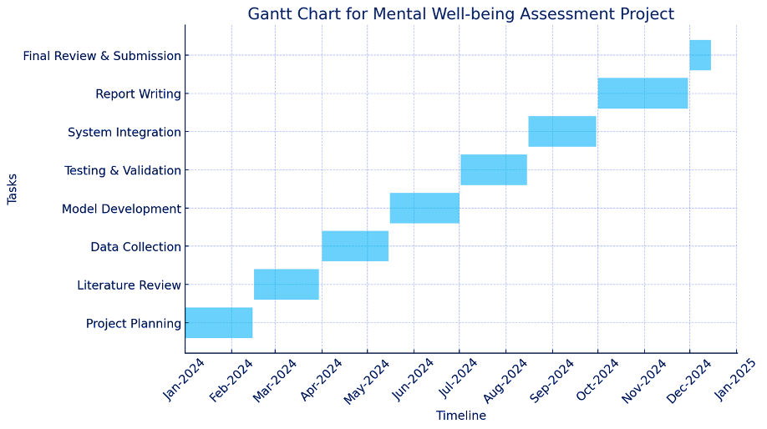

Gantt Chart
IT21802812| <<Huznadh MNM>> | <<R25-068>>

Slide 43
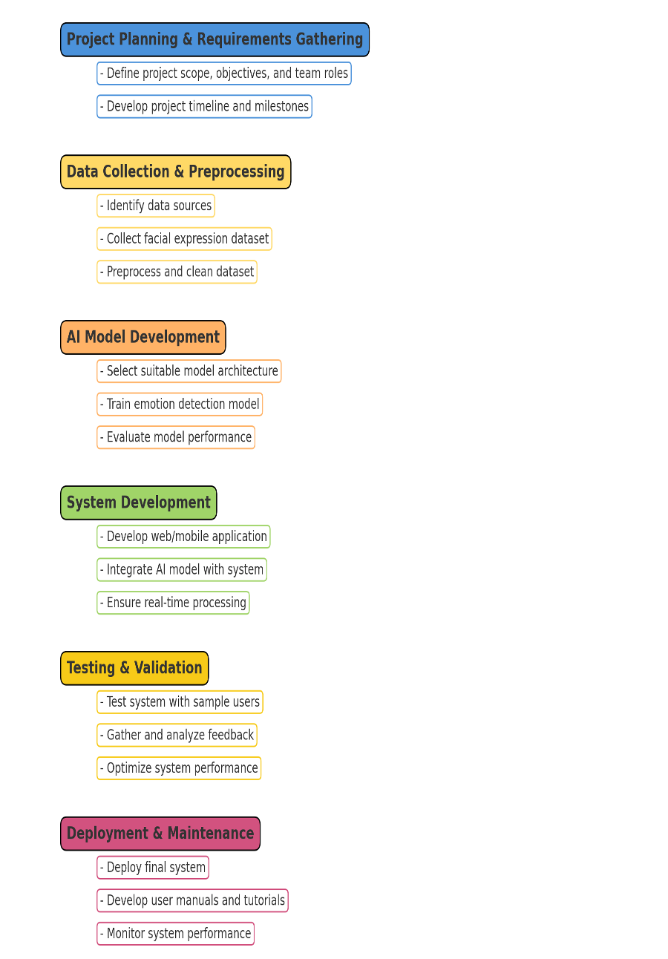
Work Breakdown Chart
IT21802812| <<Huznadh MNM>> | <<R25-068>>

Slide 44
REFERENCES
Lad, Vasant. Textbook of Ayurveda: Fundamental Principles of Ayurveda. Ayurvedic Press, 2002.
Yang, Guang-Zhong, et al. "The future of wearable technologies for personalized healthcare." Nature Electronics 1.6 (2018): 302-312.
McCall, Timothy. Yoga as Medicine: The Yogic Prescription for Health and Healing. Bantam, 2007.
Bonato, Paolo. "Wearable sensors and systems." IEEE Engineering in Medicine and Biology Magazine 29.3 (2010): 25-36.
IT21802812| <<Huznadh MNM>> | <<R25-068>>

Slide 45
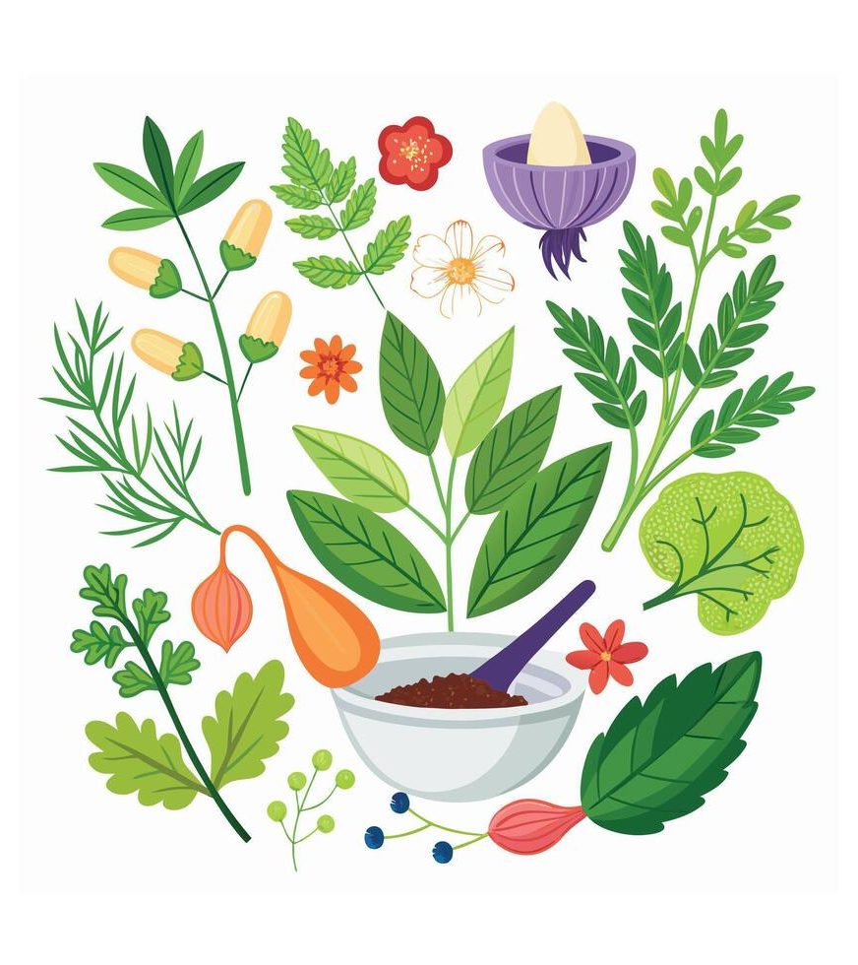
CONCLUSION
This system combines AI-driven emotion detection with Ayurvedic well-being to provide real-time stress monitoring and personalized self-care.
ensures accuracy, privacy, and accessibility, empowering users to manage their mental health effectively.
IT21802812| <<Huznadh MNM>> | <<R25-068>>

Slide 46
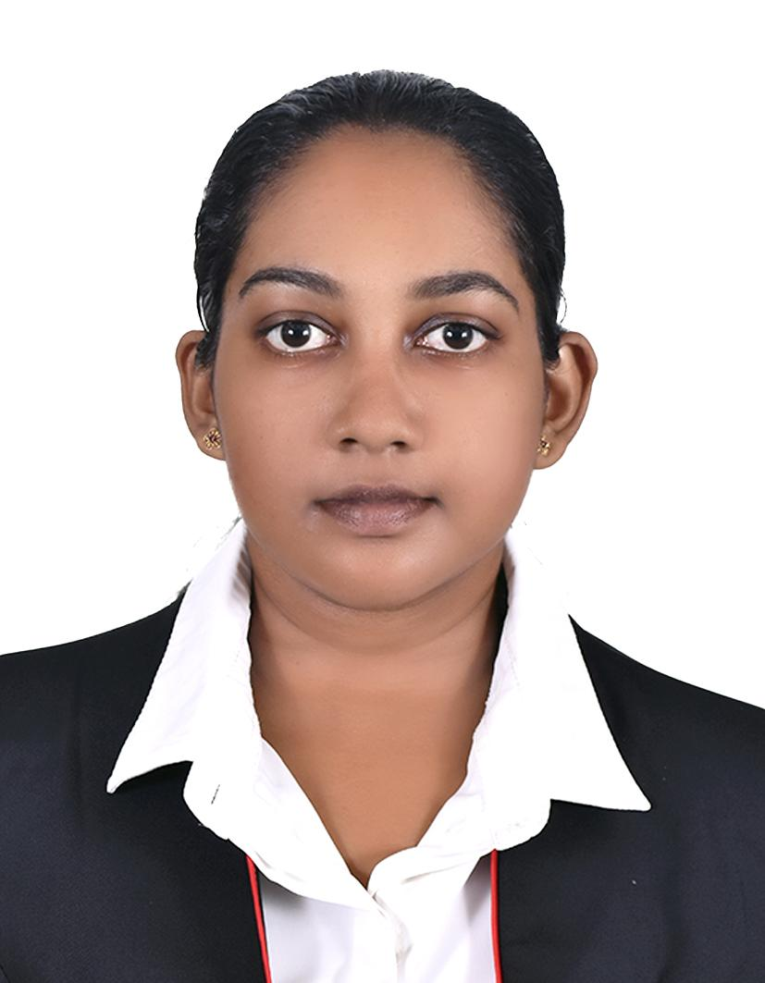
IT21190520 | Kaushalya H.G.B AI-Powered Ayurvedic Medicinal Plant Identification Using Leaf Image Processing.
Information Technology (IT)
IT21190520 | <<Kaushalya H.G.B>> | <<R25-068>>

Slide 47
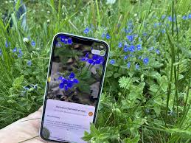
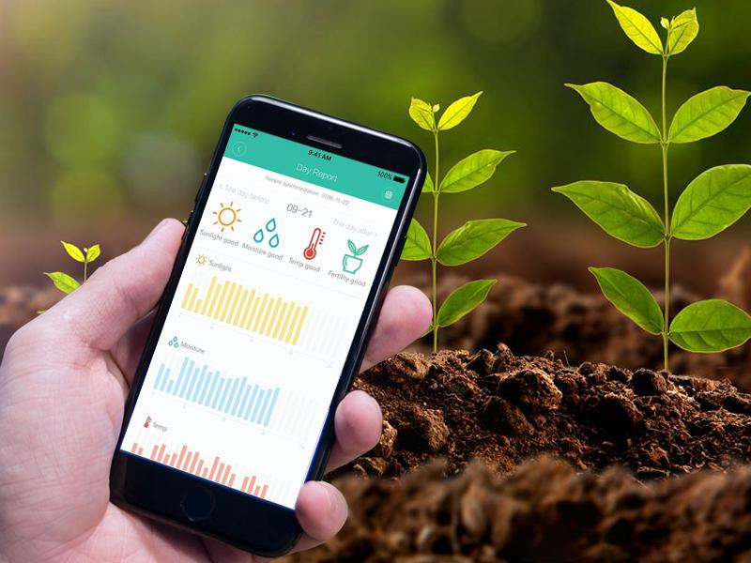
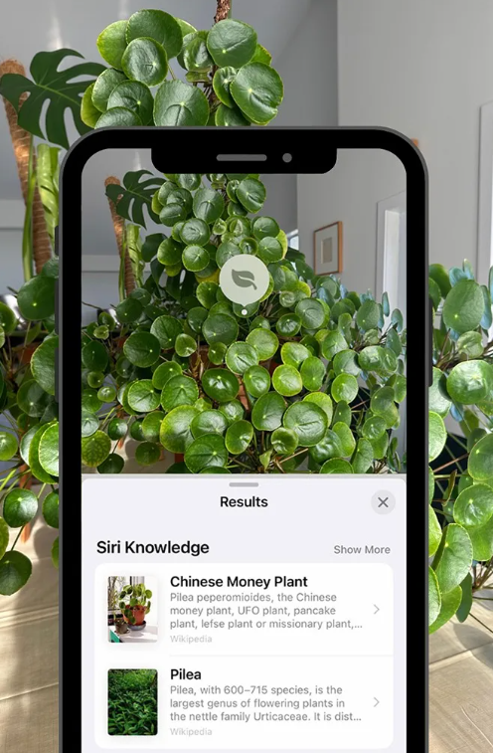
Introduction
Background
Our Ayurvedic Medicine Identification and Health Management App integrates AI and image processing.
The app helps users identify medicinal plants based on leaf images.
Provides information on plant usage for treating selected diseases.
Enhances accessibility to Ayurvedic knowledge.
IT21190520 | <<Kaushalya H.G.B>> | <<R25-068>>

Slide 48
Modified Function: Plant Identification
The model will process only static images of medicinal plant leaves.
Identification is limited to leaves only to ensure accuracy.
The system will identify medicinal plants commonly used for five specific diseases.
Once identified, the app will provide plant details, medicinal benefits, and usage guidance.

Slide 49
Selected Diseases & Common Medicinal Plants
Diabetes →
Neem (Azadirachta indica): Helps regulate blood sugar levels.
Bitter Gourd (Momordica charantia): Known for its hypoglycemic properties.
Skin Diseases →
Turmeric (Curcuma longa): Acts as a natural antiseptic and anti-inflammatory agent.
Neem (Azadirachta indica): Treats eczema, acne, and other skin infections.
Joint Pain →
Shallaki (Boswellia serrata): Reduces inflammation and pain in arthritis.
Ginger (Zingiber officinale): Contains anti-inflammatory compounds beneficial for joint health.
Digestive Disorders →
Aloe Vera (Aloe barbadensis): Soothes the digestive tract and aids in digestion.
Licorice (Glycyrrhiza glabra): Helps with acid reflux and gastric ulcers.
Respiratory Disorders →
Tulsi (Ocimum sanctum): Improves lung function and relieves cough.
Vasaka (Adhatoda vasica): Known for clearing respiratory congestion.

Slide 50
Features Comparison Table
Features | Research 1 | Research 2 | Research 3 | Research 4 | Proposed Solution
User-Friendly Interface | Low | Low | Medium | Low | High
Mobile Application | ❌ | ❌ | ✅ | ❌ | ✅
AI-Based Medicinal Plant Identification | ❌ | ❌ | ❌ | ❌ | ✅
Leaf Image Processing for Identification | ❌ | ❌ | ❌ | ❌ | ✅
Database of Ayurvedic Medicinal Plants | ❌ | ❌ | ✅ | ❌ | ✅
Disease-Based Plant Recommendation | ❌ | ❌ | ❌ | ❌ | ✅
Offline Accessibility | ❌ | ❌ | ❌ | ❌ | ✅
Integration with Ayurvedic Treatment Guidance | ❌ | ❌ | ✅ | ❌ | ✅
Machine Learning-Based Accuracy Improvement | ❌ | ❌ | ✅ | ❌ | ✅
Research
Gap
IT21190520 | <<Kaushalya H.G.B>> | <<R25-068>>

Slide 51
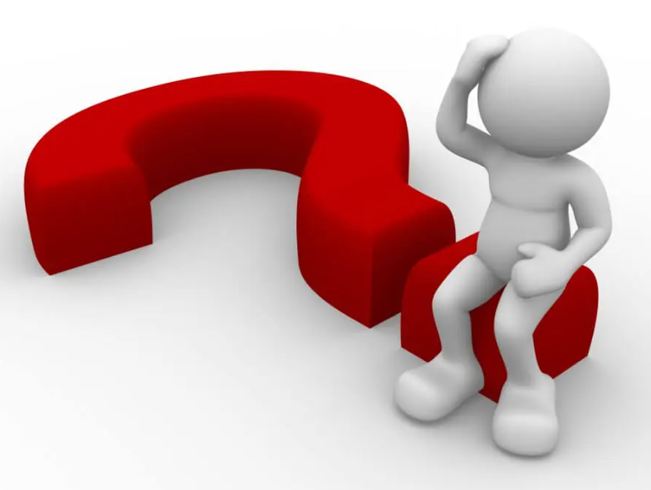
Research Problems
Limited AI Optimization: Existing AI models lack accuracy in identifying Ayurvedic medicinal plants.
Insufficient Training Data: A lack of structured datasets impacts model performance.
Complex Identification Process: Leaf variations and seasonal changes pose challenges.
Lack of Awareness: Users may not fully understand the medicinal uses of identified plants.
Offline Accessibility Issues: Reliable real-time identification is difficult in rural areas.
Need for Personalized Health Integration: Connecting identified plants to user-specific treatments remains a challenge.
IT21190520 | <<Kaushalya H.G.B>> | <<R25-068>>

Slide 52
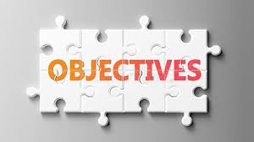
Research Objective
Primary Objective:
Develop an AI-powered plant identification system that accurately recognizes medicinal plant leaves and provides Ayurvedic treatment guidance for selected diseases.
Specific Goals:
Develop and train an AI model for accurate plant identification.
Create a medicinal plant database with Ayurvedic treatments.
Enable offline accessibility for rural users.
Integrate Ayurvedic medicinal guidance into the app.
Design a user-friendly mobile application for easy plant recognition.
Improve model accuracy with diverse plant leaf images.
IT21190520 | <<Kaushalya H.G.B>> | <<R25-068>>

Slide 53
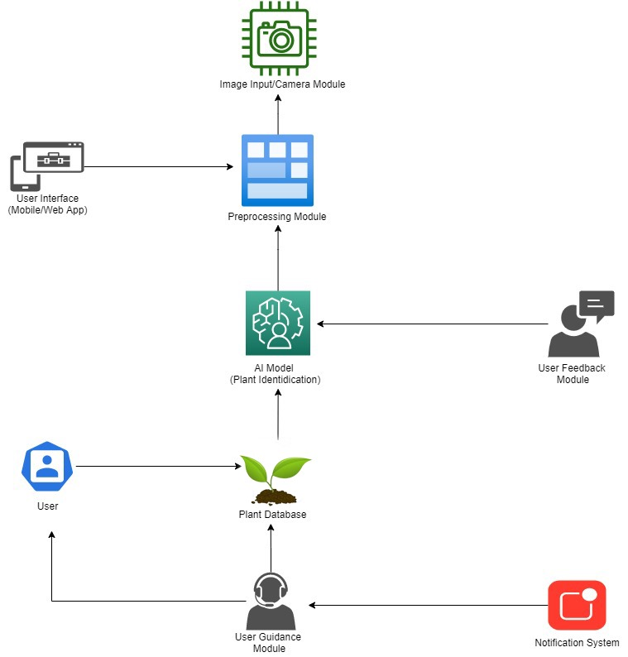
Methodology System Diagram
User Uploads Leaf Image → 2. Image Preprocessing (Enhancement & Segmentation) → 3. AI Model Identifies the Plant → 4. Displays Plant Name, Medicinal Properties, and Usage Guidance
IT21190520 | <<Kaushalya H.G.B>> | <<R25-068>>

Slide 54

Technologies Be Used
Image Processing: OpenCV
Machine Learning Model: TensorFlow / PyTorch
Database: MongoDB (for storing plant data)
Mobile App Development: Flutter
IT21190520| <<Kaushalya H.G.B>> | <<R25-068>>

Slide 55

Requirements Specification
Functional Requirements
Image-based plant identification (no live camera capture).
Database of common medicinal plants related to five diseases.
Display of plant details and Ayurvedic usage recommendations.
Offline accessibility for plant identification.
Non-Functional Requirements
Scalability: The system should support a growing number of users and plant species.
Performance: The AI model should process images and deliver results quickly.
Security: Ensure secure data storage and privacy protection for users.
Usability: The app should be intuitive and easy to navigate for all user levels.
Offline Accessibility: The app must function without internet connectivity in rural areas.
Maintainability: The system should be easy to update and expand with new plant data.
Compatibility: The app should work seamlessly on multiple mobile platforms (Android & iOS).
IT21190520 | <<Kaushalya H.G.B>> | <<R25-068>>

Slide 56
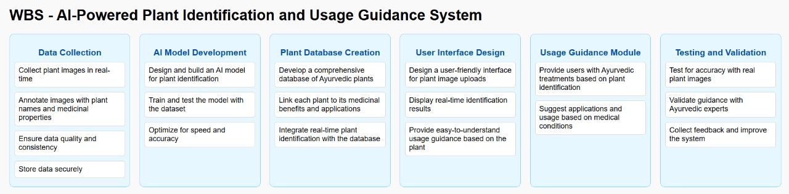
IT21190520 | <<Kaushalya H.G.B>> | <<R25-068>>​

Slide 57
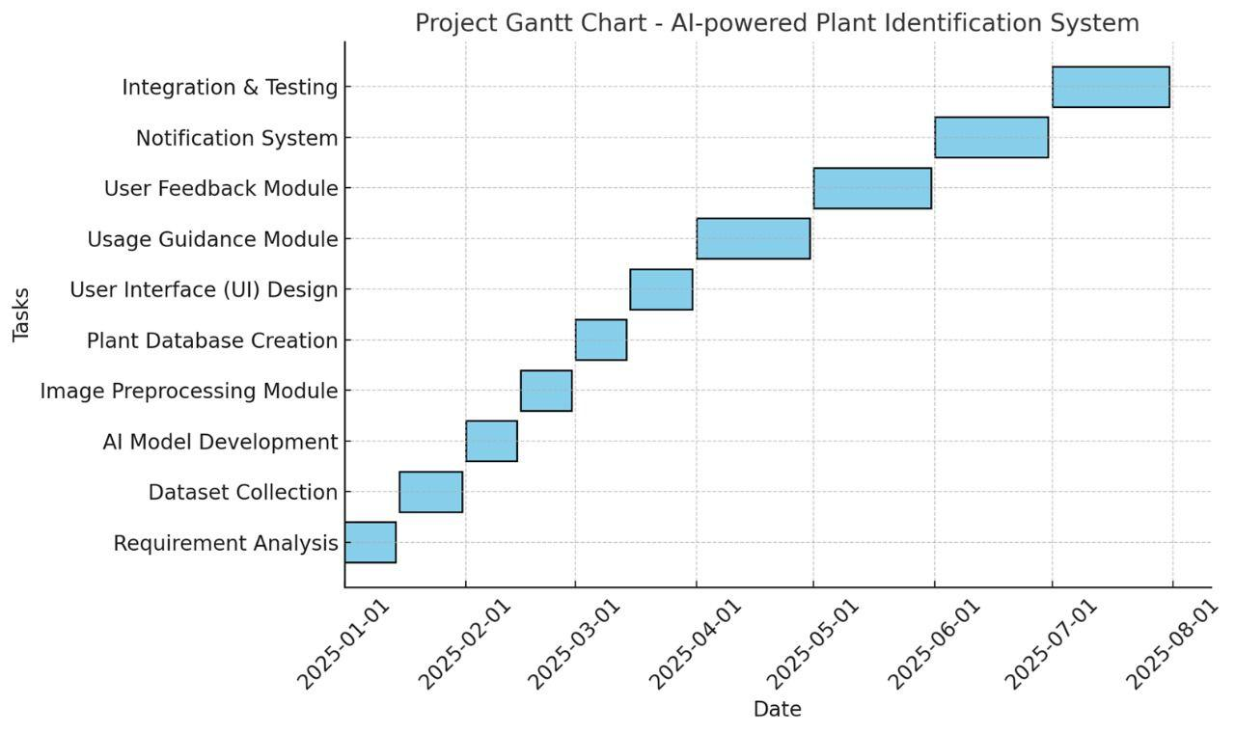
Gantt Chart
IT21190520 | <<Kaushalya H.G.B>> | <<R25-068>>

Slide 58

Supporting Items (Commercialization)
Target Market:
.Ayurvedic practitioners, students, and health-conscious individuals.
Rural and urban users seeking Ayurvedic guidance.
Partnerships:​
Ayurvedic research institutes and healthcare providers.
AI tech firms for optimization.
Government and NGOs for rural outreach.
IT21190520 | <<Kaushalya H.G.B>> | <<R25-068>>

Slide 59
References
Chaudhary, K., & Singh, N. (2020).
"Deep learning techniques for plant identification: A review." Journal of Plant Sciences, 15(4), 234-245.
[Discusses deep learning applications for plant recognition.]
Lee, J. H., et al. (2019).
"AI-powered image processing for real-time plant species identification." IEEE Transactions on Image Processing, 28(10), 5120-5132.
[Explains AI image processing for accurate identification.]
Sharma, P., & Gupta, A. (2021).
"Integrating Ayurveda and AI: A modern approach to traditional medicine." Journal of Herbal Medicine Research, 12(2), 112-120.
[Covers the integration of AI into Ayurvedic practices.]
Zhang, Y., et al. (2022).
"Mobile-based plant identification using convolutional neural networks." Computers in Biology and Medicine, 140, 105085.
[Highlights mobile applications of AI for plant recognition.]
Joshi, V., & Kulkarni, P. (2018).
"Challenges and opportunities in Ayurvedic plant identification using AI." International Journal of Botany and AI Systems, 4(3), 45-56.
[Discusses challenges in building AI-powered Ayurvedic tools.]
TensorFlow Documentation (2024).
"Deep learning for image recognition: Plant applications."
[Official guide for using TensorFlow in plant recognition.]
WHO (World Health Organization) (2021).
"Traditional medicine and modern technology: Bridging the gap."
[Global perspective on combining traditional medicine and AI.]
IT21190520 | <<Kaushalya H.G.B>> | <<R25-068>>​

Slide 60
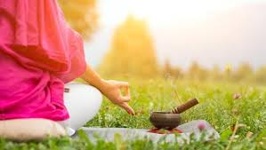
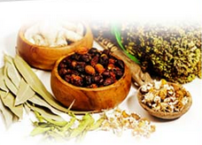
CONCLUSION
The updated AI-powered plant identification system focuses solely on image-based leaf recognition, ensuring high accuracy in identifying Ayurvedic medicinal plants for treating selected diseases. By leveraging AI and image processing, this solution bridges traditional Ayurvedic knowledge with modern technology, making plant-based health management more accessible to users.
IT21190520 | <<Kaushalya H.G.B>> | <<R25-068>>​

